Slide 1

External Analysis to analyze the competitiveness of ___ industry for _____

Slide 2
Introduction of company
Clear description of company
Business units
Is the subject of this analysis a specific business unit?
Scope
What industry is this business(unit) competing within

Slide 3
Industry
provide a clear description/positions and names of key players in that industry including scope, size, growth forecast, What is the stage of the business lifecycle? Emerging, growth, declining, mature
(use graphics here if you can)
Current/Future trends

Slide 4
Industry
Identify the main competitors (direct, indirect)
Market share
Other relevant info
Basis of competition
(use graphics here if you can)

Slide 5
Background of Company

Slide 6
Mission statement of company

Slide 7
Macro environment Analysis: PEST
Use a template explore a few factors: each factor will have an impact on your business: they can give you opportunities or pose a threat
Apply the PEST to your business
(select at least three factors: for each force, evaluate its impact on the business, is it an opportunity or threat?)
Source:
http://www.whatmakesagoodleader.com/support-files/strategic-planning-template-macro.pdf
http://pestleanalysis.com/how-to-create-pestle-analysis-template/

Slide 8
Takeaways from PEST
List any opportunities or threats found after PEST was conducted

Slide 9
Industry Analysis: Porter’s five forces

Slide 10
Purpose of Porters

Slide 11
Forces 1
Conclusion from effects of force 1 (e.g. high or 5)
Reasons to validate your conclusion ( provide a list of concrete facts)
Opportunities ( to negate the effect of the force)
Role of Information Systems

Slide 12
Forces 2
Conclusion from effects of force 2 e.g. high or 5
Reasons to validate your conclusion
Opportunities ( to negate the effect of the force)
Role of Information Systems

Slide 13
You need at least one slide for each of the five forces

Slide 14
Summary of Porters analysis
Use a table to summarize the forces (all 5 must be included)-
Role of Information Systems

Slide 15
Summary of Porters analysis
Use a table/list to summarize the Opportunities ( do not confuse threats with opportunities, see examples below)
Alliance with suppliers
Increased customer service
Acquisition
Improved products
Grow product offering
(Alternatively one can use next slide as sample)
Role of IS

Slide 16
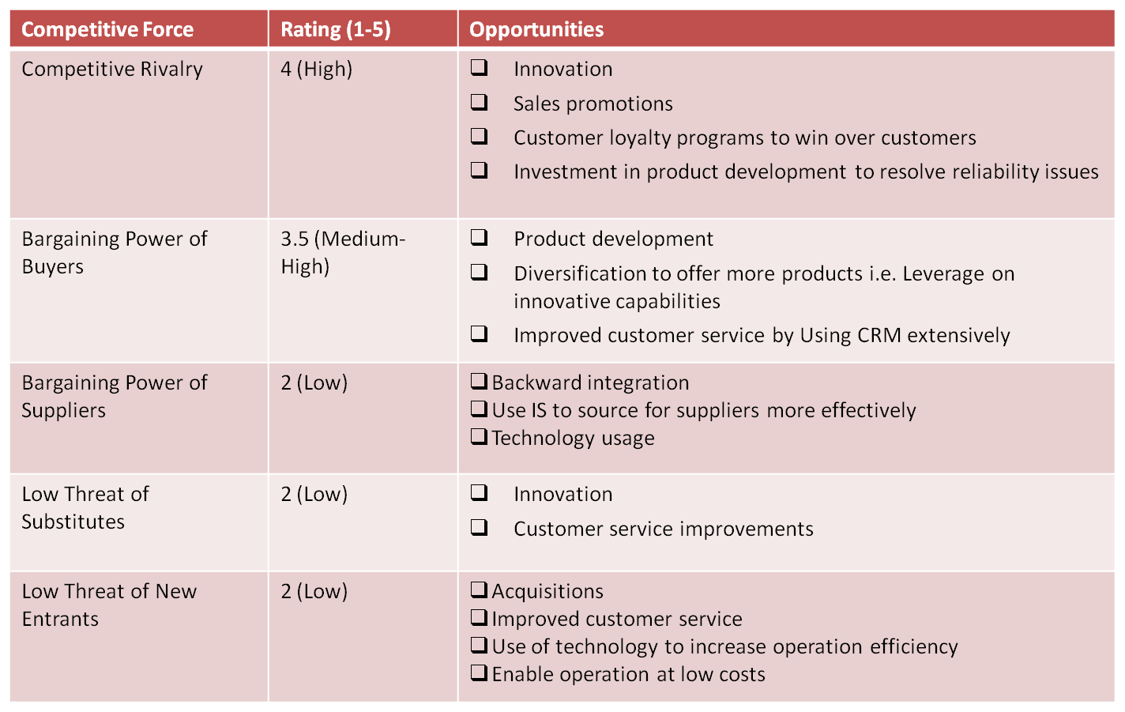
Sample table summarizing threats and listing opp.

Slide 17
Analysis of Porter’s analysis
Which forces pose the greatest threats?
-what threats should the company focus on?
Where are the company’s greatest opportunities?

Slide 18
Analysis of Porter’s analysis
What are the main drivers of competition within the industry?
(Innovation , price, technological changes)
What can you leverage to gain market share?
how do you see the company being competitive

Slide 19
Motivation for competitive strategy
Results of PEST
+
Results from Porter
+
Basis of competition in Industry
Competitive Strategy(ies) – (opportunities should signal strategies you should explore, threats you need to monitor or eliminate)

Slide 20
Recommendations

Slide 21
References

